Slide 1
STUDENT NAME: JAINUB NISHA.A
REGISTER NO. : 312215010
DEPARTMENT. : BCOM COMMERCE
COLLEGE. : SOKA IKEDA COLLEGE

Slide 2
PROJECT TITLE
Employee performance analysis using Excel

Slide 3
AGENDA
Problem Statement Project Overview End Users Our Solution and Proposition Dataset Description Modelling Approach
WOW IN OUR SOLUTION Results and Discussion Conclusion

Slide 4
PROBLEM STATEMENT
(i)To award the good performance and motivate employees who got low score.
(ii)To give promotion and increments.
(iii)To showcase in the company annual achievement ceremony.

Slide 5
PROJECT OVERVIEW
Employee performance analysis is the systematic evaluation of an employees job performance,skills and achievements to ensure they align with organizational goals. This process helps to identify strengths and areas for improvement, providing valuable insights for employee development and decision-making.
(2) By analyzing performance data, companies can enhance productivity, set more accurat goals, and tailor training programs to individual needs.

Slide 6
WHO ARE THE END USERS?
Managers and Supervisors
Human Resources (HR)
Executive and Senior Leadership
Employee themselves
Team leader

Slide 7
OUR SOLUTION AND ITS VALUE PROPOSITION
=ifs(Z8>=5,"very high",Z8>=4,"high",Z8>=3,"Med",True,"Low")
1.Filtering : Removing blank
2.IFS Formula: Finding the employee performance
3.Pivot Tables: Analysing the data
4.Graphs. : Analysing the data

Slide 8
DATASET DESCRIPTION
Employee – Kaggle
26 – features
9 – features
Name - Alphabatical
Performance level - Numerical value
Employee type - Alphabatical
Gender - Male/Female
Employee rating - Numerical value
Business unit - Alphabatical

Slide 9
MODELING APPROACH
Data connection
1.Dashboard
2.By formatting the dataset
Features collection
1.Data is collected from the dashboard
2.Formatting the data to find the employees performance level
Data cleaning
1.Identifying the missing values
2.Filter outing the missing values
Performance level
1.Employees High Performance Level
2.Employees Low Performance Level
Summary
1.Categories the performance level of the employees
Notes:
In Slide Show mode, select the arrows to visit links.

Slide 10
THE ‘WOW’ IN OUR SOLUTION
(i)=IFS(Z8>=5,”VERY HIGH”,Z8>=4,”HIGH”,Z8>=3,”MEDIUM,”TRUE,”LOW”
(ii)The above formula used to catagories the performance level of the employee is consider
as “WOW’ in my project.

Slide 11
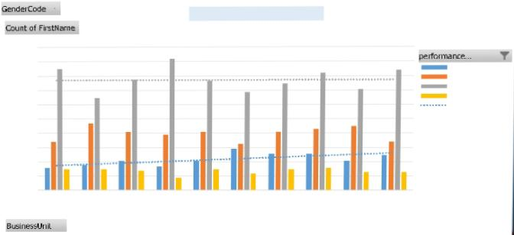
RESULTS

Slide 12
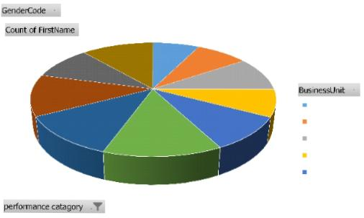
RESULTS

Slide 13
CONCLUSION
1.In overall, majority employees got “Medium” level in their performance level.
2.In BPC, Employees performed in average level.
3.In CCDR & NEL, the employees got the medium level of performance level.
4.In EW, The employees got the medium and average level of performance level in their business unit and their to know the performance of their performing level.
5. Based on the conditional formatting formula the excel sheet is formatting the solution to find the performance level of the majority employees performance based on this.

Slide 14
THANKYOU

